Slide 1
Discrete Mathematics and Its Application 7th edition, 2001
Kenneth H. Rosen

Slide 2
Welcome to Discrete Mathematics Spring 2018
Instructor: Niu Shao Zhang

Slide 3
§6.3 Permutations and Combinations
Section Summary
Permutations
Combinations
Combinatorial Proofs

Slide 4
Permutations
Definition: A permutation of a set of distinct objects is an ordered arrangement of these objects. An ordered arrangement of r elements of a set is called an r-permuation.
Example: Let S = {1,2,3}.
The ordered arrangement 3,1,2 is a permutation of S.
The ordered arrangement 3,2 is a 2-permutation of S.
The number of r-permuatations of a set with n elements is denoted by P(n,r).
The 2-permutations of S = {1,2,3} are 1,2; 1,3; 2,1; 2,3; 3,1; and 3,2. Hence, P(3,2) = 6.

Slide 5
A Formula for the Number of Permutations
Theorem 1: If n is a positive integer and r is an integer with 1 ≤ r ≤ n, then there are
P(n, r) = n(n − 1)(n − 2) ∙∙∙ (n − r + 1)
r-permutations of a set with n distinct elements.
Proof: Use the product rule. The first element can be chosen in n ways. The second in n − 1 ways, and so on until there are (n − ( r − 1)) ways to choose the last element.
Note that P(n,0) = 1, since there is only one way to order zero elements.

Slide 6
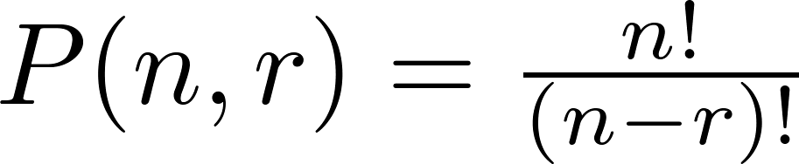
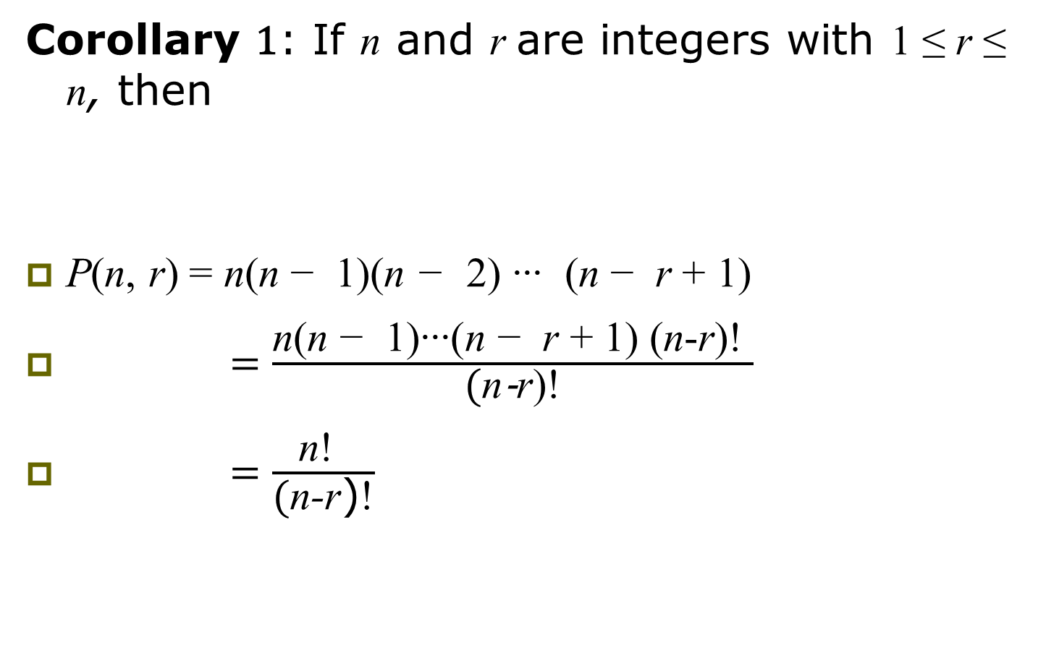
A Formula for the Number of Permutations
Corollary 1: If n and r are integers with 1 ≤ r ≤ n, then
P(n, r) = n(n − 1)(n − 2) ∙∙∙ (n − r + 1)
$=\frac{\text{n}\text{(}\text{n} \text{−} \text{1}\text{)}\text{∙∙∙}\text{(}\text{n} \text{−} \text{r}\text{ + }\text{1}\text{)}\text{ (}\text{n}\text{-}\text{r}\text{)}\text{!} }{\text{(}\text{n}\text{-}\text{r}\text{)}\text{!}}$
$=\frac{\text{n}\text{!} }{\text{(}\text{n}\text{-}\text{r}\text{)}\text{!}}$

Slide 7
Solving Counting Problems by Counting Permutations
Example: How many ways are there to select a first-prize winner, a second prize winner, and a third-prize winner from 100 different people who have entered a contest?
Solution:
P(100,3) = 100 ∙ 99 ∙ 98 = 970,200

Slide 8
Solving Counting Problems by Counting Permutations (continued)
Example: Suppose that a saleswoman has to visit eight different cities. She must begin her trip in a specified city, but she can visit the other seven cities in any order she wishes. How many possible orders can the saleswoman use when visiting these cities?
Solution: The first city is chosen, and the rest are ordered arbitrarily. Hence the orders are:
7! = 7 ∙ 6 ∙ 5 ∙ 4 ∙ 3 ∙ 2 ∙ 1 = 5040
If she wants to find the tour with the shortest path that visits all the cities, she must consider 5040 paths!

Slide 9
Solving Counting Problems by Counting Permutations (continued)
Example: How many permutations of the letters ABCDEFGH contain the string ABC ?
Solution: We solve this problem by counting the permutations of six objects, ABC, D, E, F, G, and H.
6! = 6 ∙ 5 ∙ 4 ∙ 3 ∙ 2 ∙ 1 = 720

Slide 10

Combinations
Definition: An r-combination of elements of a set is an unordered selection of r elements from the set. Thus, an r-combination is simply a subset of the set with r elements.
The number of r-combinations of a set with n distinct elements is denoted by C(n, r). The notation
is also used and is called a binomial coefficient.

Slide 11
Combinations
Example: Let S be the set {a, b, c, d}. Then {a, c, d} is a 3-combination from S. It is the same as {d, c, a} since the order listed does not matter.
C(4,2) = 6
Because the 2-combinations of {a, b, c, d} are the six subsets {a, b}, {a, c}, {a, d}, {b, c}, {b, d}, and {c, d}.

Slide 12
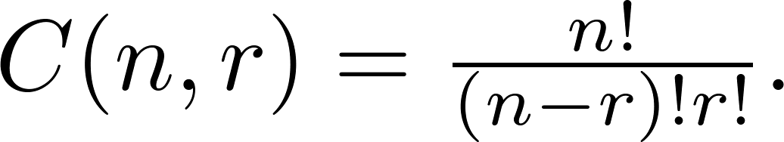
Combinations
Theorem 2: The number of r-combinations of a set with n elements, where n ≥ r ≥ 0, equals
Proof: By the product rule P(n, r) = C(n,r) ∙ P(r,r). Therefore,

Slide 13
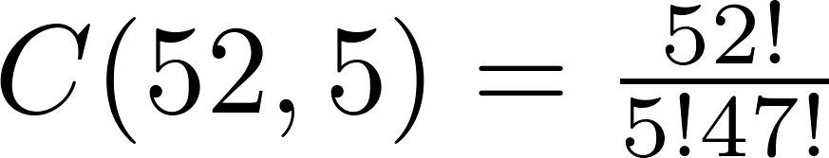
Combinations
Example: How many poker hands of five cards can be dealt from a standard deck of 52 cards? Also, how many ways are there to select 47 cards from a deck of 52 cards? (从52张扑克牌中选5张的选法有多少种？选47张呢？ 5+47=52）
Solution: Since the order in which the cards are dealt does not matter, the number of five card hands is:
The different ways to select 47 cards from 52 is

Slide 14
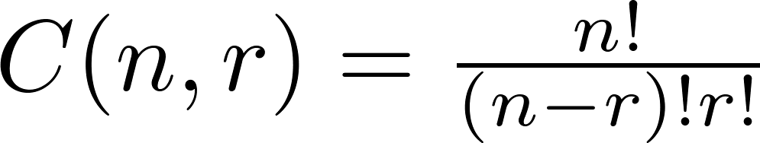
Combinations
Corollary 2: Let n and r be nonnegative integers with r ≤ n. Then
C(n, r) = C(n, n − r).
Proof: From Theorem 2, it follows that
and
Hence, C(n, r) = C(n, n − r).

Slide 15
Combinatorial Proofs
Definition 1: A combinatorial proof of an identity is a proof that uses one of the following methods.
A double counting proof （双计数证明）uses counting arguments to prove that both sides of an identity count the same objects, but in different ways.
A bijective proof （双射证明） shows that there is a bijection between the sets of objects counted by the two sides of the identity.

Slide 16

Combinatorial Proofs
Here are two combinatorial proofs that
C(n, r) = C(n, n − r)
when r and n are nonnegative integers with r < n:
（用双计数和双射两种方法分别进行证明）
Bijective Proof: Suppose that S is a set with n elements. The function that maps a subset A of S to is a bijection between the subsets of S with r elements and the subsets with n − r elements. Since there is a bijection between the two sets, they must have the same number of elements.

Slide 17
Combinatorial Proofs
Here are two combinatorial proofs that
C(n, r) = C(n, n − r)
when r and n are nonnegative integers with r < n:
Double Counting Proof: By definition the number of subsets of S with r elements is C(n, r). Each subset A of S can also be described by specifying which elements are not in A, i.e., those which are in . Since the complement of a subset of S with r elements has n − r elements, there are also C(n, n − r) subsets of S with r elements.

Slide 18
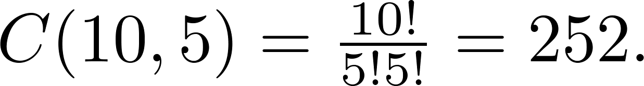
Combinations
Example: How many ways are there to select five players from a 10-member tennis team to make a trip to a match at another school.
Solution: By Theorem 2, the number of combinations is

Slide 19
Combinations
Example: A group of 30 people have been trained as astronauts to go on the first mission to Mars. How many ways are there to select a crew of six people to go on this mission?
Solution: By Theorem 2, the number of possible crews is

Slide 20
Homework
§6.3
28, 44

Slide 21
§ 6.4 Binomial Coefficients and Identities
Section Summary
The Binomial Theorem
Pascal’s Identity and Triangle
Other Identities Involving Binomial Coefficients (not currently included in overheads)

Slide 22


Binomial Theorem
Binomial Theorem: Let x and y be variables, and n a nonnegative integer. Then:
Proof: We use combinatorial reasoning . The terms in the expansion of (x + y)^{n} are of the form x^{n−j}y^{j} for j = 0,1,2,…,n. To form the term x^{n−j}y^{j}, it is necessary to choose n−j xs from the n sums. Therefore, the coefficient of x^{n−j}y^{j} is which equals.

Slide 23
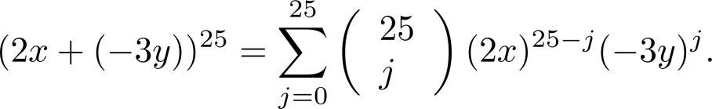
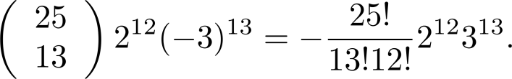
Using the Binomial Theorem
Example: What is the coefficient of x¹²y¹³ in the expansion of (2x − 3y)²⁵?
Solution: We view the expression as (2x +(−3y))²⁵. By the binomial theorem
Consequently, the coefficient of x¹²y¹³ in the expansion is obtained when j = 13.

Slide 24
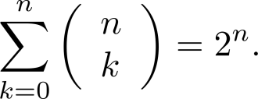
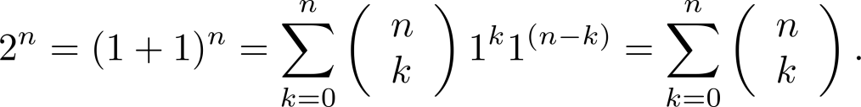




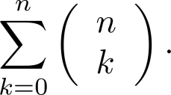
A Useful Identity
Corollary 1: With n ≥0,
Proof (using binomial theorem): With x = 1 and y = 1, from the binomial theorem we see that:
Proof (combinatorial): Consider the subsets of a set with n elements. There are subsets with zero elements, with one element, with two elements, …, and with n elements. Therefore the total is
Since, we know that a set with n elements has 2^{n} subsets, we conclude:

Slide 25
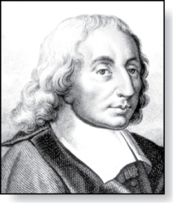
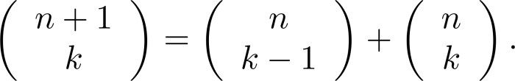



Pascal’s Identity
Blaise Pascal
(1623-1662)
Pascal’s Identity: If n and k are integers with n ≥ k ≥ 0, then
Proof (combinatorial): Let T be a set where |T| = n + 1, a ∊T, and S = T − {a}. There are subsets of T containing k elements. Each of these subsets either:
contains a with k − 1 other elements,
or contains k elements of S and not a.
There are
subsets of k elements that contain a, since there are subsets of k − 1 elements of S,
subsets of k elements of T that do not contain a, because there are subsets of k elements of S.
Hence,

Slide 26
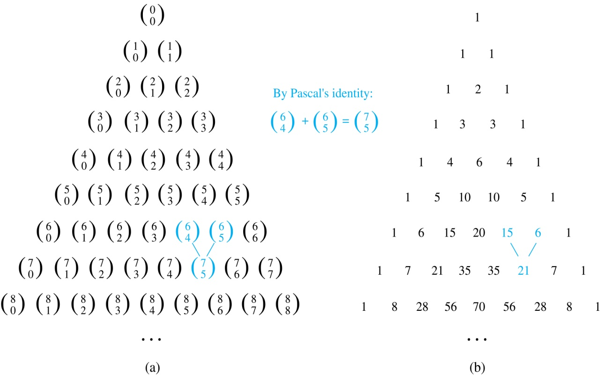
Pascal’s Triangle
The nth row in the triangle consists of the binomial coefficients ,
k = 0,1,….,n.
By Pascal’s identity, adding two adjacent bionomial coefficients results is the binomial coefficient in the next row between these two coefficients.

Slide 27
No Homework

